Slide 1




Applied Analytics
Text Analytics & Topic Analysis
Terminology
History
Linguistics
Statistical Machine Learning
STAT 656 – Applied Analytics using SAS© Enterprise Miner™
Week 8
Copyright © 2014 Edward R Jones ALL RIGHTS RESERVED

Slide 2
Week 8
✔ Topics – Week 8
WEEK | DATE | TOPICS | ASSIGNMENT (due following week)
1 | May 21 | Introduction to Data Mining, Python and SAS Enterprise Miner | HW1: RIE & Linear Reg with Diamond Price Data
2 | May 28 | Data Preprocessing & Linear Regression | HW2: Linear Reg with Oil Production Data & 70/30 Assessment
3 | June 4 | Logistic Regression, The Confusion Matrix and Model Metrics | HW3: Logistic Regression with Fraud Detection
4 | June 11 | Decision Trees & Cross Validation | HW4: Cell Phone Activity Classification
5 | June 18 | Random Forests | Midterm Exam – Take Home
6 | June 25 | Neural Networks | HW6: Optional: Apply Keras to building a Neural Network
7 | July 2 | Genetic Algorithms for Advanced Feature Selection | HW7: Optional: Apply GA Selection to Diamond Prices
8 | July 9 | Speaker (6-7) & Introduction to Text Analytics (7-9) | HW8: Analysis of Wine Reviews in SAS EM and Python
9 | July 16 | Capstone Updates (6-7) & Topic Analysis (7-9) | HW9: Topic Analysis
10 | July 23 | Degree Plans (6-6:30) & Sentiment Analysis (6:30-9) | HW10: Sentiment Analysis
11 | July 30 | Final Exam & Web Scraping | Final Exam Open – Return Thursday, Aug 6
12 | Aug. 10 | Review of Final Exam & Grades | This is an optional Q&A Session

Slide 3
Text Analytics
Topic Analysis
✔ WEEK 8 LEARNING OBJECTIVES – Able to…
1
Understand unsupervised topic analysis in EM & Python
2
Practice Topic Analysis using NTHSA DATA

Slide 4

Applied Analytics
Week 7
Optional Assignment
GA Feature Selection
STAT 656 – Applied Analytics using SAS© Enterprise Miner™
Copyright © 2014 Edward R Jones ALL RIGHTS RESERVED

Slide 5
Week 7
✔ Optional Assignment – Feature Selection
Data: diamonds_train (Excel File) Select the best features then build a linear regression model using these features. Compare GA selection to Stepwise, the Full Model, and Lasso or Regularized Regression
Data Dictionary: DiamondsDictionary(PDF file) The target is an interval attribute labeled “price”. The predictors consist of 6 interval features and 3 nominal features.
Hold-Out Sample: diamonds_validation(Excel file) File contains the same columns as the training data.
Assignment: This is an optional assignment, but since GA Selection is not in SAS EM, you can only use Python for this assignment.

Slide 6
Week 7
✔ Python Template for GA Features with Interval Target
Data: OilProduction(Excel File) Data on the oil production from fracking wells.
Data Dictionary: OilProduction_Data_Dictionary(PDF file) The target is an interval attribute labeled “Log_Cum_Production”. The predictors consist of 10 interval and 2 nominal features.
Template: GA_OilProduction(Python .py file) This code contains the latest template for implementing GA Selection, Stepwise and Lasso Selection for Interval Targets
Assignment: Modify this template to conduct a similar analysis of the diamond price data.

Slide 7
Week 7
✔ Python Imports for GA Features with Interval Target
deap: A python package for genetic algorithms. Install using from inside your working Anaconda environment:
conda install -c conda-forge deap

Slide 8
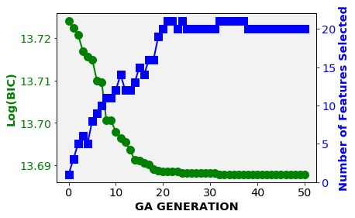
Week 7
✔ Solution
GA_HW7.py: A solution to this assignment is posted in the week 7 assignment folder.
GA Solution: Found you can minimize BIC with 20 features: carat, depth, table, x, and most of the levels from the 3 nominal features..

Slide 9
Week 7
✔ Python Template for GA Features with Interval Target
Full Model: 23 Features. Train BIC = 880,159 & Validation ASE = 471,688
Interval Features(6): carat, depth, table, x, y and z
Nominal Features(17): All except the last column for each nominal feature.
Cut(5-1): All except cut=very good
Color(7-1): All levels except color=J
Clarity(8-1): All levels except clarity=VVS2
GA Selection: 20 Features. Train BIC = 880,133 & Validation ASE = 472,808
Interval Features(4): carat, depth, table and x
Nominal Features(16):
Cut(5-2): Fair, Good and Ideal (missing 2)
Color(7-1): All levels except color=G
Clarity(8-1): All levels except clarity=VS1

Slide 10
Week 7
✔All Features: logreg.display_split_metrics

Slide 11
Week 7
✔ GA Selection from 50 Generations

Slide 12
Week 7
✔ GA Selection

Slide 13
Week 7
✔ GA Selection: logreg.display_split_metrics

Slide 14
Week 7
✔ Stepwise vs. Lasso (same features different model)
Stepwise: 21 Features. Train BIC = 880,139 & Validation ASE = 471,775
Interval Features(4): carat, depth, table and x
Nominal Features(17): All except the last column for each nominal feature.
Cut(5-1): All except cut=very good
Color(7-1): All levels except color=J
Clarity(8-1): All levels except clarity=VVS2
Lasso: 21 Features. Train BIC = 880,945 & Validation ASE =458,401
Interval Features(4): carat, depth, table and x
Nominal Features(17): missing last column of each nominal feature
Cut(5-1): Fair, Good, Ideal and Good
Color(7-1): All levels except color=J
Clarity(8-1): All levels except clarity=VVS2

Slide 15
Week 7
✔ stepwise: logreg.display_split_metrics

Slide 16
Week 7
✔ Lasso alpha=4: logreg.display_split_metrics

Slide 17
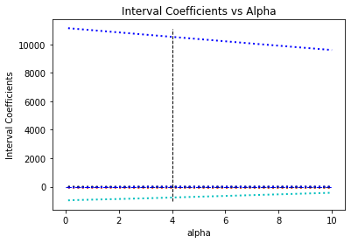
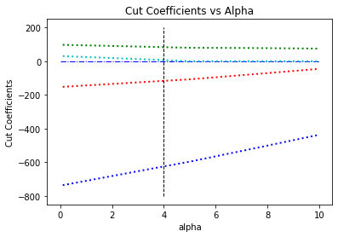
Week 7
✔ Lasso Coefficients vs Alpha

Slide 18
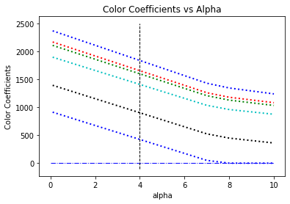
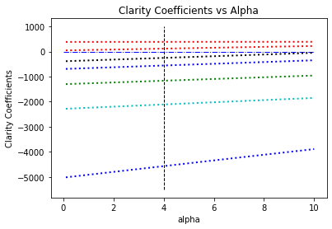
Week 7
✔ Lasso Coefficients vs Alpha

Slide 19
Applied Analytics
Introduction to Text Analytics
Week 8
STAT 656 – Applied Analytics using SAS© Enterprise Miner™
Copyright © 2014 Texas A&M Statistical Services ALL RIGHTS RESERVED

Slide 20
DATA HIERARCHY
TEXT
SEMI-STRUCTURED
UNSTRUCTURED
STRUCTURED

Slide 21
History & Evolution 1950-1985
Linguistics
Rationalist Views
Advocated by Noam Chomsky (MIT)
“Language is an innate human faculty. Children do not learn natural language from limited input during their early years”
Humans are born with language processing, not just pattern recognition.
AI researchers developed application-specific rules and algorithms for solving problems.

Slide 22
History & Evolution Post 1985
Linguistics
Rise of Empiricist & Computational Linguistics
Computers and large collections of annotated text became available.
Humans are born with the biology for learning language, not a detailed set of language rules.
Language is learned using pattern recognition and statistical thinking.
Example: “The British left waffle on the Falklands.”

Slide 23
Corpus: Linguistic Data (60s-Present)
Brown Corpus (1960s)
Developed at Brown University by Kucera and Francis
Balanced annotated corpus of 500 fiction and nonfiction documents
Used for IR Research – Statistical Similarity of Documents
London-Lund Corpus (LLC, 1970s)
Lancaster-Oslo-Bergen (LOB, 1980s) Corpus
Similar to Brown Corpus, but for British English
Penn TreeBank Corpus (1980s)
Developed at Penn State University
2,499 Wall Street Journal stories.
Available in different languages, and as recorded speech.
American National Corpus (ANC, 2000s)
22 million word subcorpus
Google N-Gram Corpus (2000s) (up to 5-gram)
1 trillion words from web pages
New ISO and Specialized Corpus Developed (2010s)
Twitter, Facebook and Blogs
Specialized Domains

Slide 24
Computational Linguistics
The use of rule-based and/or statistical modeling of natural language
Rule-based approaches are rules for extract parts-of-speech and convert raw text into meaningful data structures.
Used for speech recognition and synthesis
Statistical approaches use annotated text, dictionaries and rules to model the relationships between text and meaning.
Used for POS tagging, colocation, entity Extraction
Reduce language ambiguity
Used for extracting domain specific knowledge

Slide 25
Statistical Machine Learning
Statistical approaches for NLP that develop models from corpus designed to discover topics.
The annotated corpus is data where each word is tagged with a POS.
Statistical Machine Learning develops a model for predicting word POS, identifying noun groups, entities and topics.
A corpus is valuable for customizing the model. A corpus is language specific and often topic specific.

Slide 26
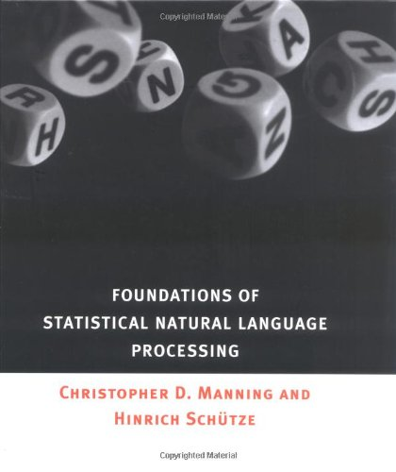
Linguistics – Statistical Machine Learning
Manning C.D. and Schutze, H. (1999) Foundations of Statistical Natural Language Processing, MIT Press.
Indurkhya, N. and Damerau, R. J. (2010) Handbook of Natural Language Processing; CRC Press.
Pustejovsky, J. and Stubbs, A. (2012) Natural Language Annotation for Machine Learning; O’Reilly.
Others – Google Stanford Natural Language Laboratory

Slide 27
Text Analysis using Word Counts
TOKENIZATION
IDENTIFY SENTENCE, WORD & SYMBOLS
LABELING WORDS WITH PARTS OF SPEECH
STOP WORD FILTER
REMOVING WORDS THAT DO NOT CONTAIN INFORMATION
STEMMING
OPTIONAL – MAP ALL WORD TENSES TO THEIR ROOT WORD
POS TAGGING
TEXT ANALYSIS
BAG OF WORDS ANALYSIS

Slide 28
✔ Approaches to Text Analysis in Non-HP SAS Enterprise Miner: Sample-Parse-Filter-Cluster
Import Single File (Excel) with Column of Text Entries
Read Single File (SAS) with a Column of Text Entries
Import Multiple Files from a Single Directory

Slide 29
✔ Approaches to Text Analysis in Non-HP SAS Enterprise Miner: Sample-Parse-Filter-Cluster
Import Single File (Excel) with Column of Text Entries
Topic Clusters

Slide 30
✔ Approaches to Text Analysis in HP SAS Enterprise Miner: Sample-Parse-Filter-Cluster
Read Single File (SAS) or Import a File (Excel) with a Column of Text Entries and a Key Column.
Set Variable Roles

Slide 31
✔ Approaches to Text Analysis in HP SAS Enterprise Miner: Sample-Parse-Filter-Cluster
Read Single File (SAS) or Import a File (Excel) with a Column of Text Entries and a Key Column.
Topic Clusters

Slide 32
Term Frequency
The Term Matrix is a t by d matrix where t is the number of terms (words) in the collection and d is the number of documents.
Element f_{ij} is the number of times the ith term occurs in the jth document.
Many of the term frequencies are zero.
Raw term frequencies are larger for larger documents.

Slide 33
Term-Doc Matrix
✔ A matrix with t rows and d columns
DOCUMENTS
Many values will be zero.
Larger docs will have larger term frequencies
f₁₁
f₁₂
f₁₃
…
f_{1d}
T E RM
S
f₂₁
f₂₂
f₂₃
…
f_{2d}
f₂₁
f₂₂
f₃₃
…
f_{3d}
.
.
.
.
.
.
.
.
.
.
.
.
.
.
.
f_{t1}
f_{t2}
f_{t3}
…
f_{td}
Term Frequencies by Document

Slide 34
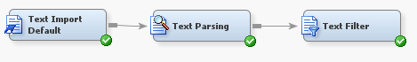
Term-Doc Matrix
✔ Create the Matrix – Sample-Parse-Filter
Parse Text
Filter Text
Read Text

Slide 35
Term-Doc Matrix
✔ Import
Usually Increase Maximum Text Size Above 100
Consider Using Synonym List
Consider Changing Frequency & Term Weights
Default has no Synonyms

Slide 36
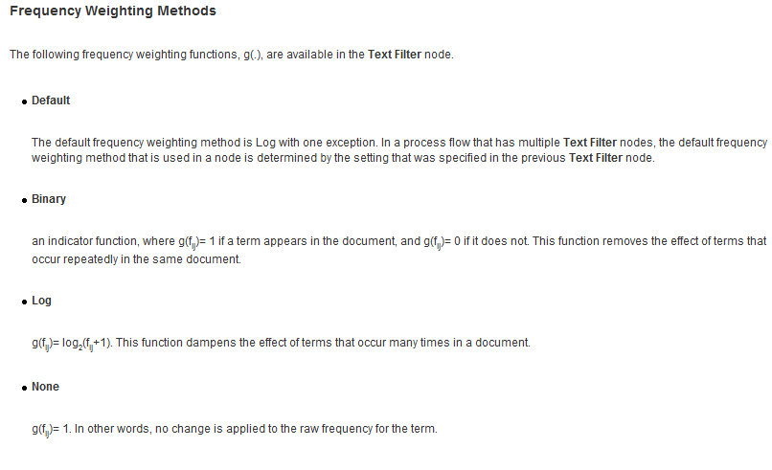
Text Filter Node
✔ Text Filter Node – Frequency Weights
Default Frequency Weight is Log(f+1)
Must Set to None for Sentiment Analysis

Slide 37
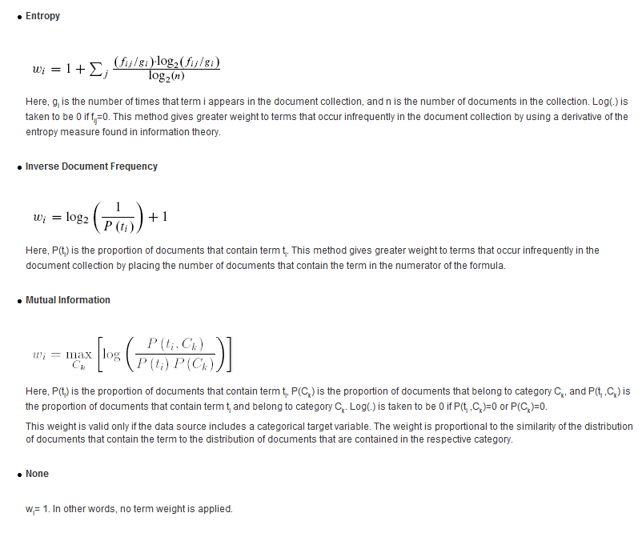
Text Filter Node
✔ Text Filter Node – Term Weights
Default Weight is Entropy for Interval Targets
IDF – Popular Alternative
Default Weight is Mutual Information for Categorical Targets

Slide 38
Term-Doc Matrix
✔ Import
Default Frequency Weight is Log(f+1)
Default Term Weight is Entropy or Mutual Information
Consider Setting Term Weight to IDF

Slide 39
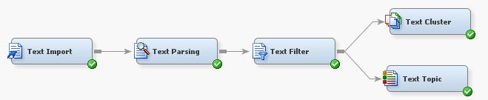
Topic Analysis
✔ Two Approaches
Cluster Analysis Node
Topic Analysis Node

Slide 40
Topic Analysis
✔ Two Approaches in SAS EM
Cluster Analysis
Mathematically Determined
Independent Topics: Documents assigned only 1 topic
Topic Analysis Node
User Driven
Allows for Non-Independent Topics: Documents can be assigned multiple topics

Slide 41
Topic Analysis
✔ SVD Based
Both approaches start with a Singular Value Decomposition of the Term-Document Matrix
The Matrix can be weighted and customized with POS, Synonyms, Stop Words and Stemming
Cluster Analysis is the SVD solution followed by the Min-Max Rotation of the Solution to better identify independent document clusters.
Topic Analysis uses SVD and Rotations but allows user to further refine topic clusters.

Slide 42
SVD
✔ Singular Value Decomposition of Term-Doc Matrix
DOCUMENTS
Term-Document Matrix (T)
f₁₁
f₁₂
f₁₃
…
f_{1d}
T E RM
S
f₂₁
f₂₂
f₂₃
…
f_{2d}
f₂₁
f₂₂
f₃₃
…
f_{3d}
.
.
.
.
.
.
.
.
.
.
.
.
.
.
.
f_{t1}
f_{t2}
f_{t3}
…
f_{td}
Identifies Term Clusters

Slide 43
SVD: Singular Value Decomposition
SVD Transforms the Term-Document Matrix - T:
Where U is a t x k orthonormal matrix, with t=number of terms
V is k x d orthonormal, with d=number of documents, and
Σ is k x k diagonal matrix containing the eigenvalues of T.
k is the rank of T, where k ≤ t and k ≤ d.
Normally k is equal to the number of topic clusters

Slide 44
SVD Rotations
The Term-Document matrix can be rotated:
Given an SVD solution there are an infinite number of equally good solutions defined by P.
Most software do not allow for rotations. The SAS EM uses a Varimax Rotation to better identify meaningful topic clusters.
This rotation is not done in Python SVD.

Slide 45
Normalized Term Frequency
Term frequencies depend on the size of the document.
There are several ways to normalize the term frequencies.
Normalize using largest frequency or total word count
tf_{ij} = f_{ij} / max(f_{1j} , f_{2j} , … f_{nj} )
tf_{ij} = f_{ij} / sum(f_{1j} , f_{2j} , … f_{nj} )

Slide 46
Inverse Document Frequency
If d = total number of documents, the idf_{i} for the ith term is:
idf_{i} = log(d/d_{i} ) where d_{i} is the number of documents in the collection that contain the ith term.
0 ≤ idf_{i} ≤log(d), for all terms
The inverse document frequency is a measure of how many documents contain the ith term.
idf_{i} = 0, if every document contains the ith term
idf_{i} = log(d), if the ith term appears in only one document

Slide 47
IDF for Python Sklearn
If d = total number of documents, the idf_{i} for the ith term is:
idf_{i} = log[(d+1)/(d_{i} +1)] where d_{i}=number of documents containing the ith term.
0 ≤ idf_{i} ≤log((d+1)/2), for all terms
The inverse document frequency is a measure of how many documents contain the ith term.
idf_{i} = 0, if every document contains the ith term
idf_{i} = log[(d+1)/2], if the ith term appears in only one document

Slide 48
TF-IDF (most software)
The term weight TF-IDF is the term frequency weighted by the inverse document frequency.
w_{ij} = f_{ij} x idf_{i}
If all documents contain the ith term, w_{ij} = 0 .
If only one document contains the ith term then the raw term frequency f_{ij} is increased by log(d).
Essentially TF-IDF reduces the term frequency for terms that appear in all or most documents and increases the term frequency when the term appears only in a small number of documents.

Slide 49
TF-IDF (Python sklearn)
The term weight TF-IDF is the term frequency weighted by the inverse document frequency.
w_{ij} = f_{ij} x log[(d+1)/(d_{i} +1)] If all documents contain the ith term, w_{ij} = 0 .
If only one document contains the ith term then the raw term frequency f_{ij} is increased by log(d/2).
Essentially TF-IDF reduces the term frequency for terms that appear in all or most documents and increases the term frequency when the term appears only in a small number of documents.

Slide 50
Other Term Weights
TF-IDF is only one of a class of term weighting schemes. In general the weight term weight can be expressed as:
t_{ij} = wgt_{i} x g(f_{ij} ), where g(f) is a non-decreasing function of f.
Typical values for the term weight wgt_{i} are:
Entropy
Mutual Information for applications with a categorical target
wgt_{i} = 1

Slide 51
Choices for g(f)
The function g(f_{ij}) is typically selected to reduce the extreme spread in term frequencies. The most frequent terms often have values over 1,000; whereas the 10th ranked term might have a value in the 10’s.
Typical values for the term function are:
g(f_{ij} ) = 1
g(f_{ij} ) = log(f_{ij}+1)
Binary: g(f_{ij}) = 1 if f_{ij} > 0; otherwise g(f_{ij}) = 0

Slide 52
Recommendations
The choice for wgt_{i} and g(f_{ij}) depends on the application.
Applications where the documents in the collection are about the same size and the documents are large, the choice for wgt_{i} and g(f_{ij} ) are not important.
If the raw term frequencies are large for a few terms and smaller for the rest, use g(f_{ij} ) = log(f_{ij}+1) or the binary function.
If the size of the documents vary considerably, weight g(f_{ij} ) by the inverse document frequency wgt_{i} = log(d/df_{i})

Slide 53
Applied Analytics
Text Cluster Node
STAT 656 – Applied Analytics using SAS© Enterprise Miner™
Copyright © 2014 Texas A&M Statistical Services ALL RIGHTS RESERVED

Slide 54
Topic Analysis
✔ Customer Reviews of Las Vegas Hotels
Data
1,671 customer reviews of Las Vegas Hotels
Objective
Identify major review topics (categories)
Identify hotels associated with topics

Slide 55
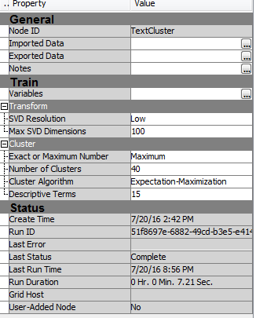
Cluster Analysis
✔ Cluster Analysis Default Properties
Cluster Analysis
Default Properties
Common Property Changes:
Maximum to Exact
Number of Clusters to less than 10
SVD Resolution to Medium

Slide 56
Cluster Analysis
✔ Results from using default properties
Cluster Analysis
6 topics
Topic’s Word Description

Slide 57
Cluster Analysis
✔ Example – Six Topic Clusters using SVD
Cluster Analysis Description
Number of Documents for Each of the 6 Topics
SVD Vectors (U)
Total Number is 1,671 The number of Reviews

Slide 58
Applied Analytics
Text Topic Node
STAT 656 – Applied Analytics using SAS© Enterprise Miner™
Copyright © 2014 Texas A&M Statistical Services ALL RIGHTS RESERVED

Slide 59
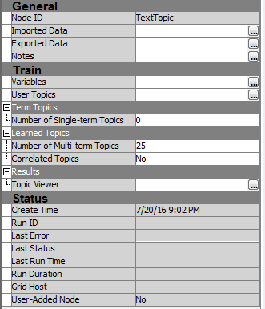
Text Topic Node
✔ Text Topic Node Default Properties
Text Topic Node
Default Properties
Interactive Topic Viewer
Common Property Changes:
Number of Multi- Term Topics
Correlated Topics
Use topic viewer to create Relevant Topics

Slide 60
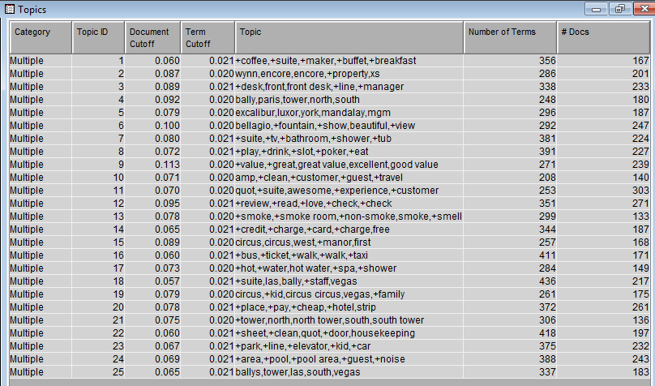
Text Topic Node
✔ Results from using default properties
Default Number of Identified Topics (25)

Slide 61
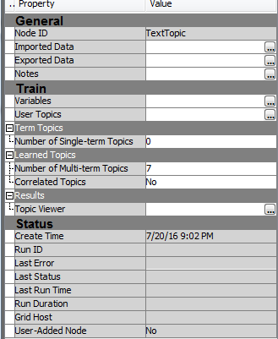
Text Topic Node
✔ Text Topic Node Modified Properties
Text Topic Node
Changed Number of Topics from 25 to 7
Cluster Analysis Identified 6 topics
In general set the initial number of multi-term topics to approximately the number of topics found with Text Cluster.

Slide 62
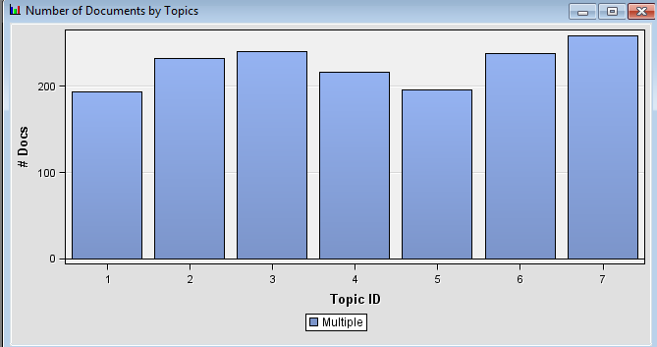
Text Topic Node
✔ Results from using default properties
6 topics
Number of Docs Associated with Each Topic
Initial Number of Identified Topics (7)

Slide 63
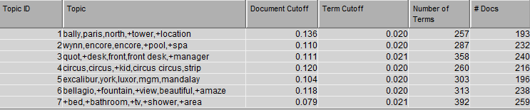
Text Topic Node
✔ Results from Restricting Number of Topics to 7
Initial Number of Identified Topics (7)
Total Number is 1,574 a Little Less than Number of Reviews
Number of Docs Associated with Each Topic

Slide 64
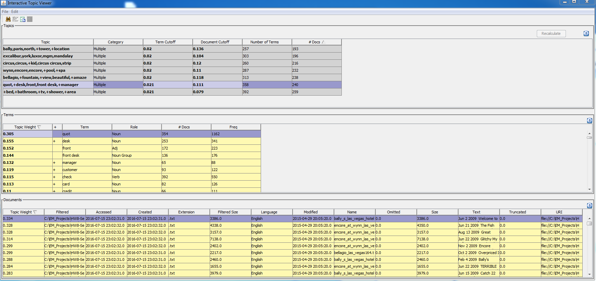
Text Topic Node
✔ Topic Viewer – Used to Shape Topics
Topic Viewer
Term Viewer
Document Viewer

Slide 65
Text Topic Node
✔ Topic Viewer – Used to Shape Topics
Initial 7 Topics
Initial Term Weights
Individual Docs /Reviews

Slide 66
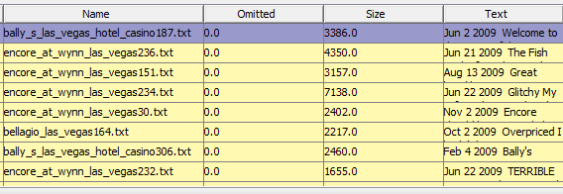
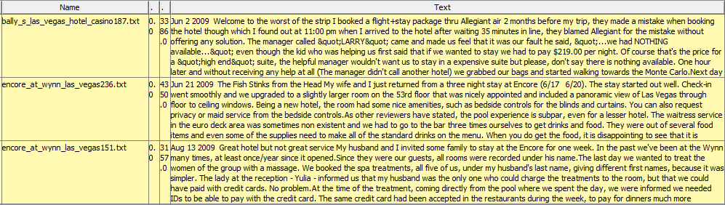
Text Topic Node
✔ Select a Topic to View Associated Documents
Individual Customer Reviews
Top 3 Reviews Representing Topic 6
Topic 6 Documents Ordered by Relevance

Slide 67
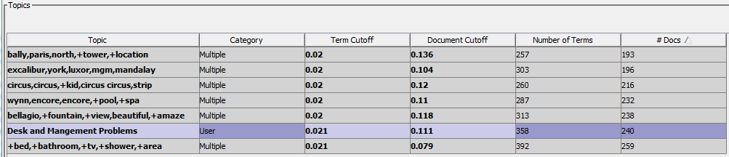
Text Topic Node
✔ Label Topic With Meaningful Description
Topic Descriptions
Document Cutoff
Number of Documents
User Described Topic
Category Automatically Changes to User

Slide 68
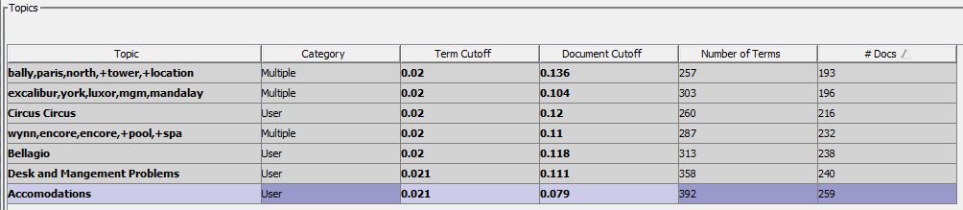
Text Topic Node
✔ Labeled 4 USER Topics
Topic Descriptions
The total number of Docs from all topics should be close to the total number of Docs in the Data (N=1,671)
Total = 1,574
The SVD score for a document must be above the Cutoff for it to be considered in that topic.
User Described Topic
4 USER Topics

Slide 69
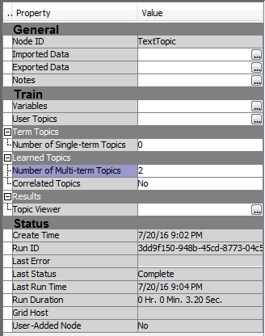
Text Topic Node
✔ Save USER Topics and Request More
Request only 2-3 New Multiple Topics
Near the End, Allow Correlated Topics
Return to the Topic Viewer to See New Topics

Slide 70
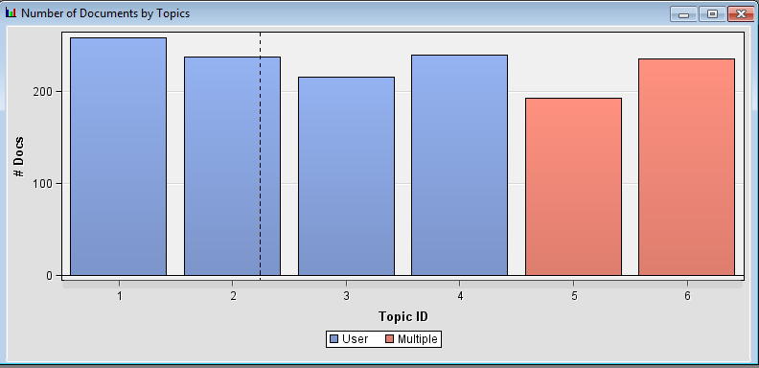
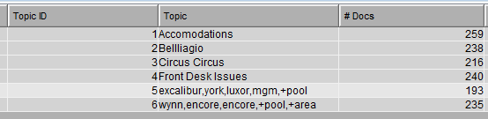
Text Topic Node
✔ Review New Topics Using Topic Viewer
Two New Topics from SVD
Previously Defined USER Topics
Review and Shape New Multi-Term Topics
In this case, new topics are similar to previous topics. In general they can change.

Slide 71
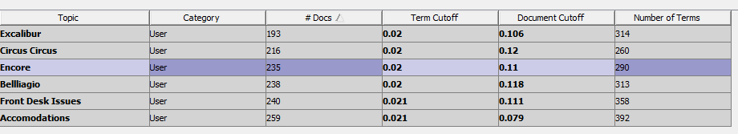
Text Topic Node
✔ All User Topics
All USER Topics
Check Total Number of Docs to See If This is Close to Number in Data (N=1,671)

Slide 72
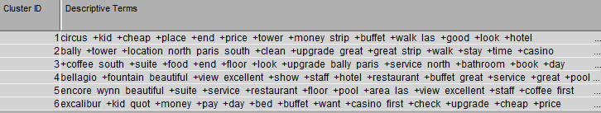
Text Topic Node
✔ Cluster Topics Vs. Text Topic Node
Cluster Analysis Topics
Text Topic Node Solution

Slide 73
Next
Week 9
✔ Next Week
Topic Analysis and Document Classification
Sentiment Analysis (Week 10)
Final Exam (Week 11)

